Slide 1

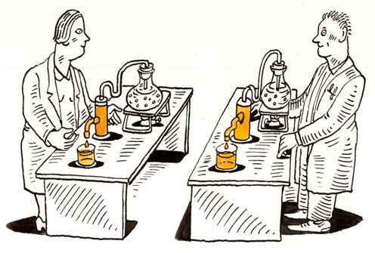

Introduction to Reproducible Science
Nelson Roque, PhD
Scan for
Slides & Code available on GitHub
Notes:
Image: https://www.displayr.com/what-is-reproducible-research/
https://events.ucf.edu/event/2891771/reproducible-data-science/
Friday, March 24, 2023 3 p.m. to 4:30 p.m.
Learn how to develop a code-only pipeline to allow reproducibility of data prep and analyses, and how to develop a long-term learning plan for practicing reproducible science tools and techniques. This virtual workshop will describe the tools and techniques for reproducible science, one of the tenants of FAIR principles of scientific data management.
Color transition

Slide 2
We need scalable
open-source tools to
support accessible
education and research.

Slide 3
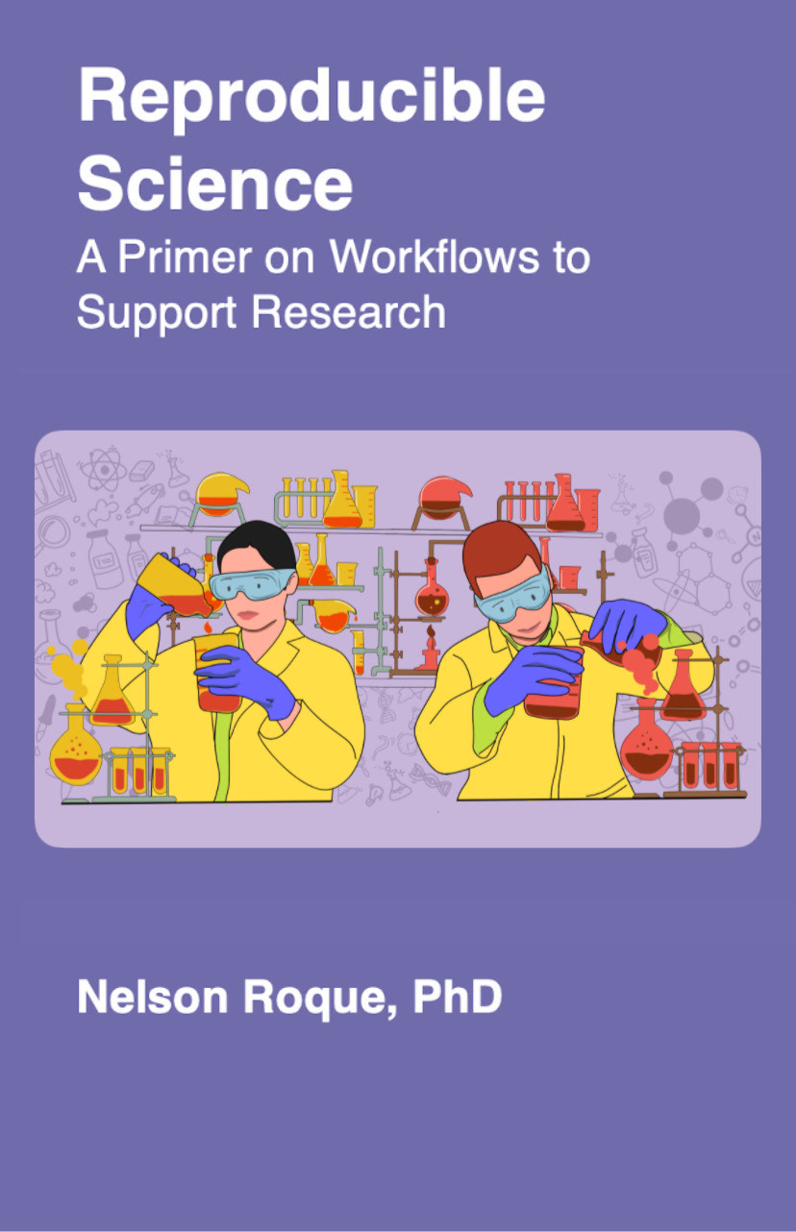
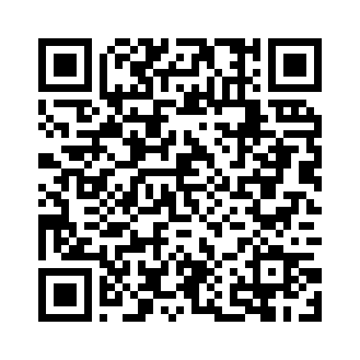
Commitment to Reproducible Science
Train the next-generation of scientists to work with data - regardless of the type, format, or volume.
Make available a set of open-source materials to learn how to engage in reproducible science, leveraging code-based techniques.
This repository is intended to house various sample workflows, and code snippets, to support research + data science activities

Slide 4
Workshop Learning Objectives
Describe various principles, tools and techniques supportive of open and reproducible science.
List and describe the FAIR Principles (https://www.go-fair.org/fair-principles)
Develop a code-only pipeline to allow reproducibility of data prep and analyses.
Learn about data wrangling principles (e.g., tidy data)
Import, pre-process & visualize data using R
Develop a long-term learning plan for practicing reproducible science tools and techniques.
Share recommended readings, activities for continued learning

Slide 5
Agenda
What is Reproducible Science?
Reproducible & FAIR Data Workflows
Tools Supporting Reproducible Science, Overview of available tools
Skill 1: Using Reference Management Software
Skill 2: Using Git (and Github) for code management and collaboration
Orientation to R, RStudio, RMarkdown
Skill 3: R syntax primer
Data wrangling and visualization of Big Data
Skill 4: Data wrangling the Google Mobility dataset
Interacting with APIs and JSON data
Skill 5: querying API for results and data aggregation
Data Science: Latest trends
Long-term Learning Recommendations
Closing Discussion & Q/A
Notes:
How version control works
Show diagrams of branches and merges, pull requests

Slide 6

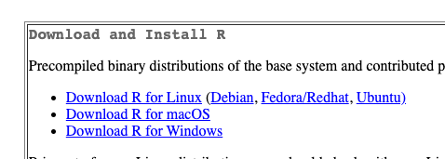

Software Required for Workshop
R - https://cran.r-project.org/
RStudio - https://posit.co/download/rstudio-desktop

Slide 7
About this Workshop
All slides, code, and recordings will be made available at the website listed below, as well as Github
Code & Slides
https://github.com/nelsonroque/contextlab_reproduciblescience_workshops
Textbook
https://nelsonroque.github.io/contextlab_introdatascience_webcourse/

Slide 8

Icebreaker: In the chat…
Name, lab affiliation
What does reproducible science mean to you?
Which tools have you previously used?
Which tools are you most excited to learn?

Slide 9
What is Reproducible Science?

Slide 10
In a 2016 survey published in Nature, over 70% of 1576 researchers
who attempted to replicate
another scientist's experiment
were unsuccessful.
Notes:
A reproducibility crisis (Ioannidis, 2005; Open Science Collaboration, 2015) has emerged as a threat to the scientific enterprise.
Ioannidis, John P A. 2005. “Why Most Published Research Findings Are False.” PLoS Medicine 2 (8): e124. doi:10.1371/journal.pmed.0020124.
Munafò, M. R., Nosek, B. A., Bishop, D. V., Button, K. S., Chambers, C. D., Percie du Sert, N., ... & Ioannidis, J. (2017). A manifesto for reproducible science. Nature human behaviour, 1(1), 1-9.
Open Science Collaboration. 2015. “Estimating the Reproducibility of Psychological Science.” Science 349 (6251): aac4716–aac4716. doi:10.1126/science.aac4716.

Slide 11
What is reproducible science?
Making entire scientific process transparent (as allowable; often required by law, grants).
Sharing experiment, raw data, and analysis code
Detailed methods sections
Sharing stimulus sets
Being able to walk through a data analysis start (load raw data) to finish (manuscript analyses) in code
Following FAIR Principles
Pre-registering hypotheses and analysis plans (e.g., on OSF)
Notes:
More on this: https://www.displayr.com/what-is-reproducible-research/

Slide 12
Benefits of reproducible research
Increased likelihood that the research will be correct
Reproducibility makes it easier to check the research
It is easier to reproduce the research independently
Easier to extend the research
Reusable code and instruction resulting in increased efficiencies
https://www.displayr.com/what-is-reproducible-research

Slide 13
Reproducible versus replicable
Reproducible: when the exact results can be reproduced if given access to the original data, software, or code
Replicable: research results can be reproduced by independent researchers using different methods.

Slide 14

Improving Usability of Reproducible Research
Hundreds of reporting guidelines exist to enhance usability of research

Slide 15
Reproducible & FAIR Data Workflows

Slide 16
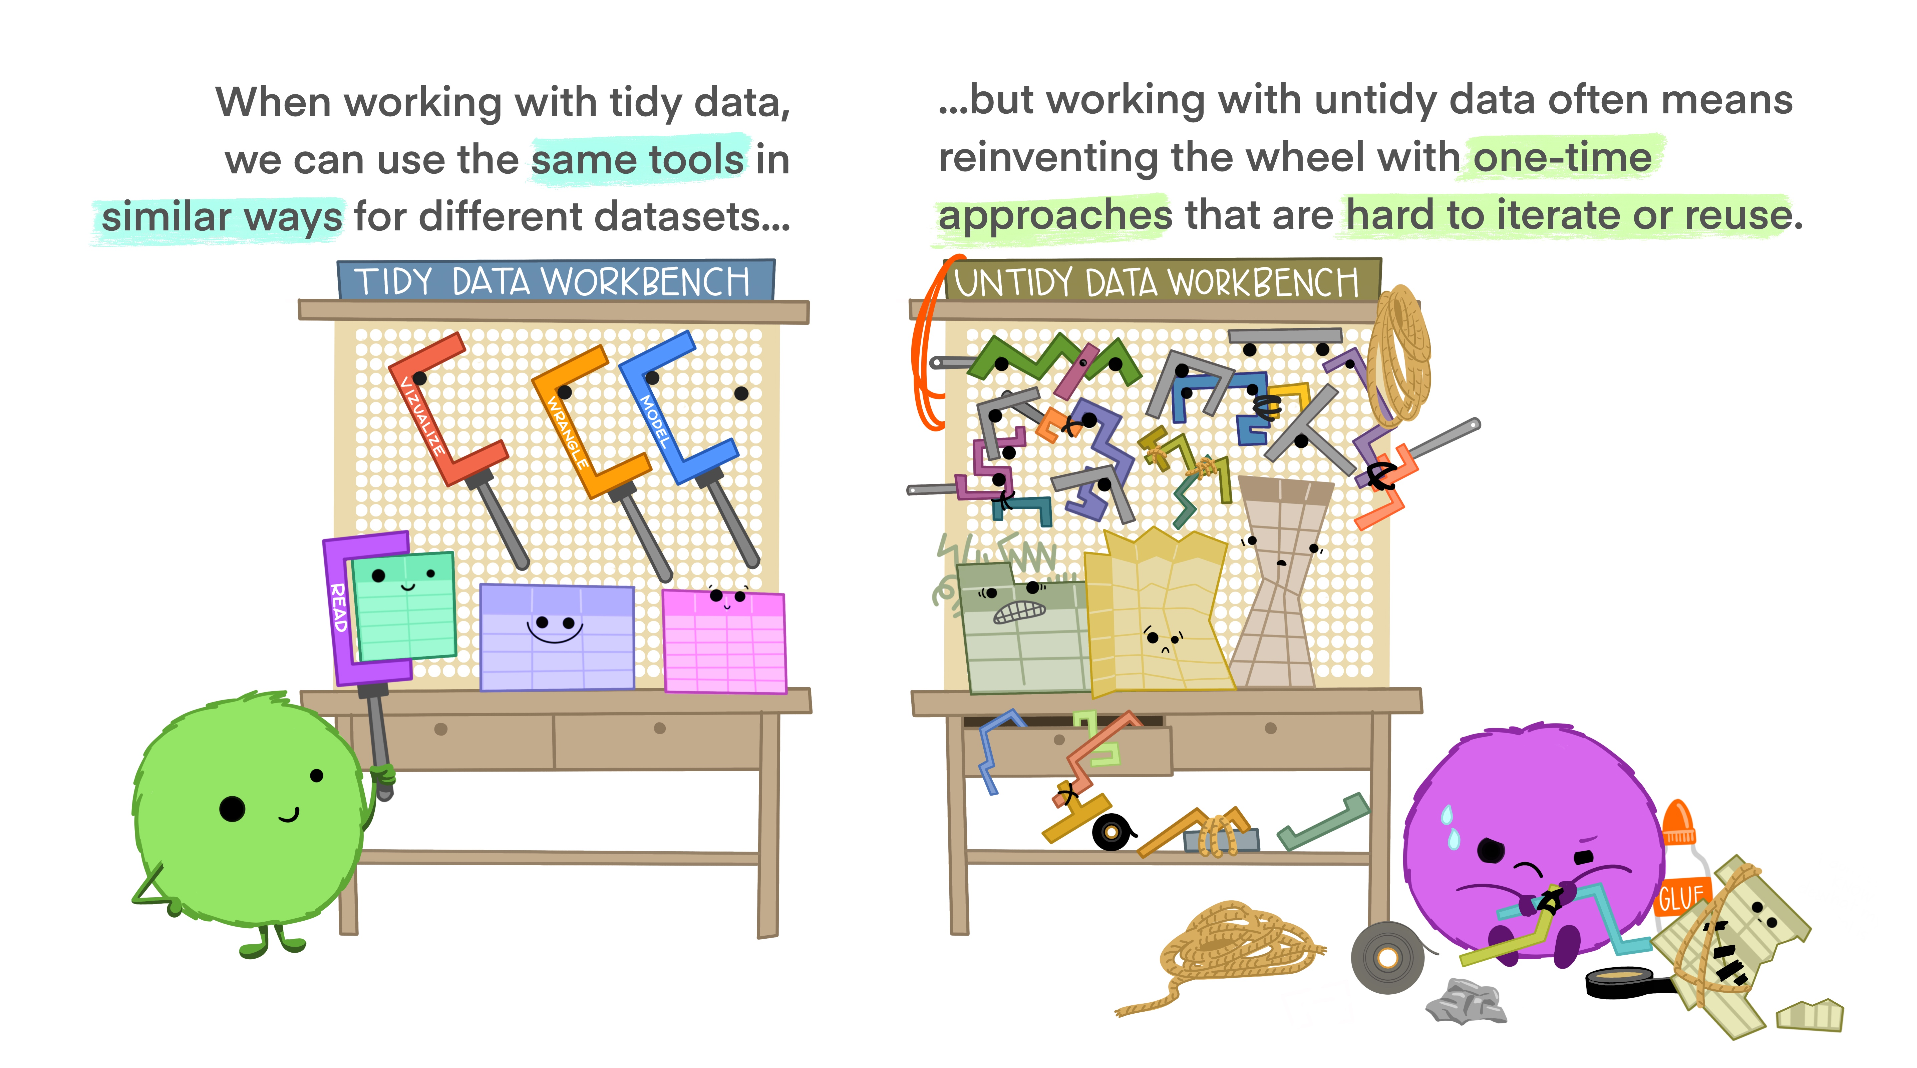
Notes:
Illustrations from the Openscapes blog Tidy Data for reproducibility, efficiency, and collaboration by Julia Lowndes and Allison Horst

Slide 17

Reproducible Workflows
Documented, code-based approach to pre-processing and analytics
R (RMarkdown), Python (Jupyter notebooks)
File versioning with clear changelogs
Git and Github
https://monashdatafluency.github.io/r-rep-res/

Slide 18
FAIR Principles
F
Findable: "The first step in (re)using data is to find them. Metadata and data should be easy to find for both humans and computers. Machine-readable metadata are essential for automatic discovery of datasets and services”
Accessible: "Once the user finds the required data, she/he/they need to know how they can be accessed, possibly including authentication and authorisation.”
Interoperable: "The data usually need to be integrated with other data. In addition, the data need to interoperate with applications or workflows for analysis, storage, and processing.”
Reusable: "The ultimate goal of FAIR is to optimise the reuse of data. To achieve this, metadata and data should be well-described so that they can be replicated and/or combined in different settings."
A
I
R
https://www.go-fair.org/fair-principles
Notes:
Learn more about the FAIR Principles
https://www.go-fair.org/fair-principles
https://www.go-fair.org/wp-content/uploads/2022/01/FAIRPrinciples_overview.pdf

Slide 19
Tools Supporting
Reproducible Science

Slide 20
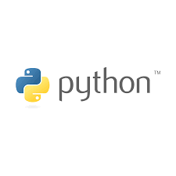










Tools Supporting Reproducible Science
Reference Managers
Latex, Markdown
R, Python, Anaconda
Github, Github Pages: https://pages.github.com
Docker, VMs
Infrastructure as Code (IaC; e.g., AWS CDK)
IDEs (e.g., Visual Studio Code)
Open Science Framework
Documentation software: Docusaurus, https://docusaurus.io
Code-based experiment creation software: Opensesame, Psychopy, jsPsych

Slide 21
Reference Management
What are Reference Managers?
A software suite to manage citations and facilitate the creation of bibliographies (like Zotero, Mendeley)
Guide from the UCF library with installation links: https://guides.ucf.edu/citations-endnote
Why Endnote?
no need for manual tracking (deleting, updating) of references
change citation format at click of a button
capture PDFs for any citations at click of a button
Downloads:
[Mac](http://ezproxy.library.ucf.edu/loggedin/EndNote20SiteInstaller.zip)
[Windows](http://ezproxy.library.ucf.edu/loggedin/EndNote20.zip)

Slide 22
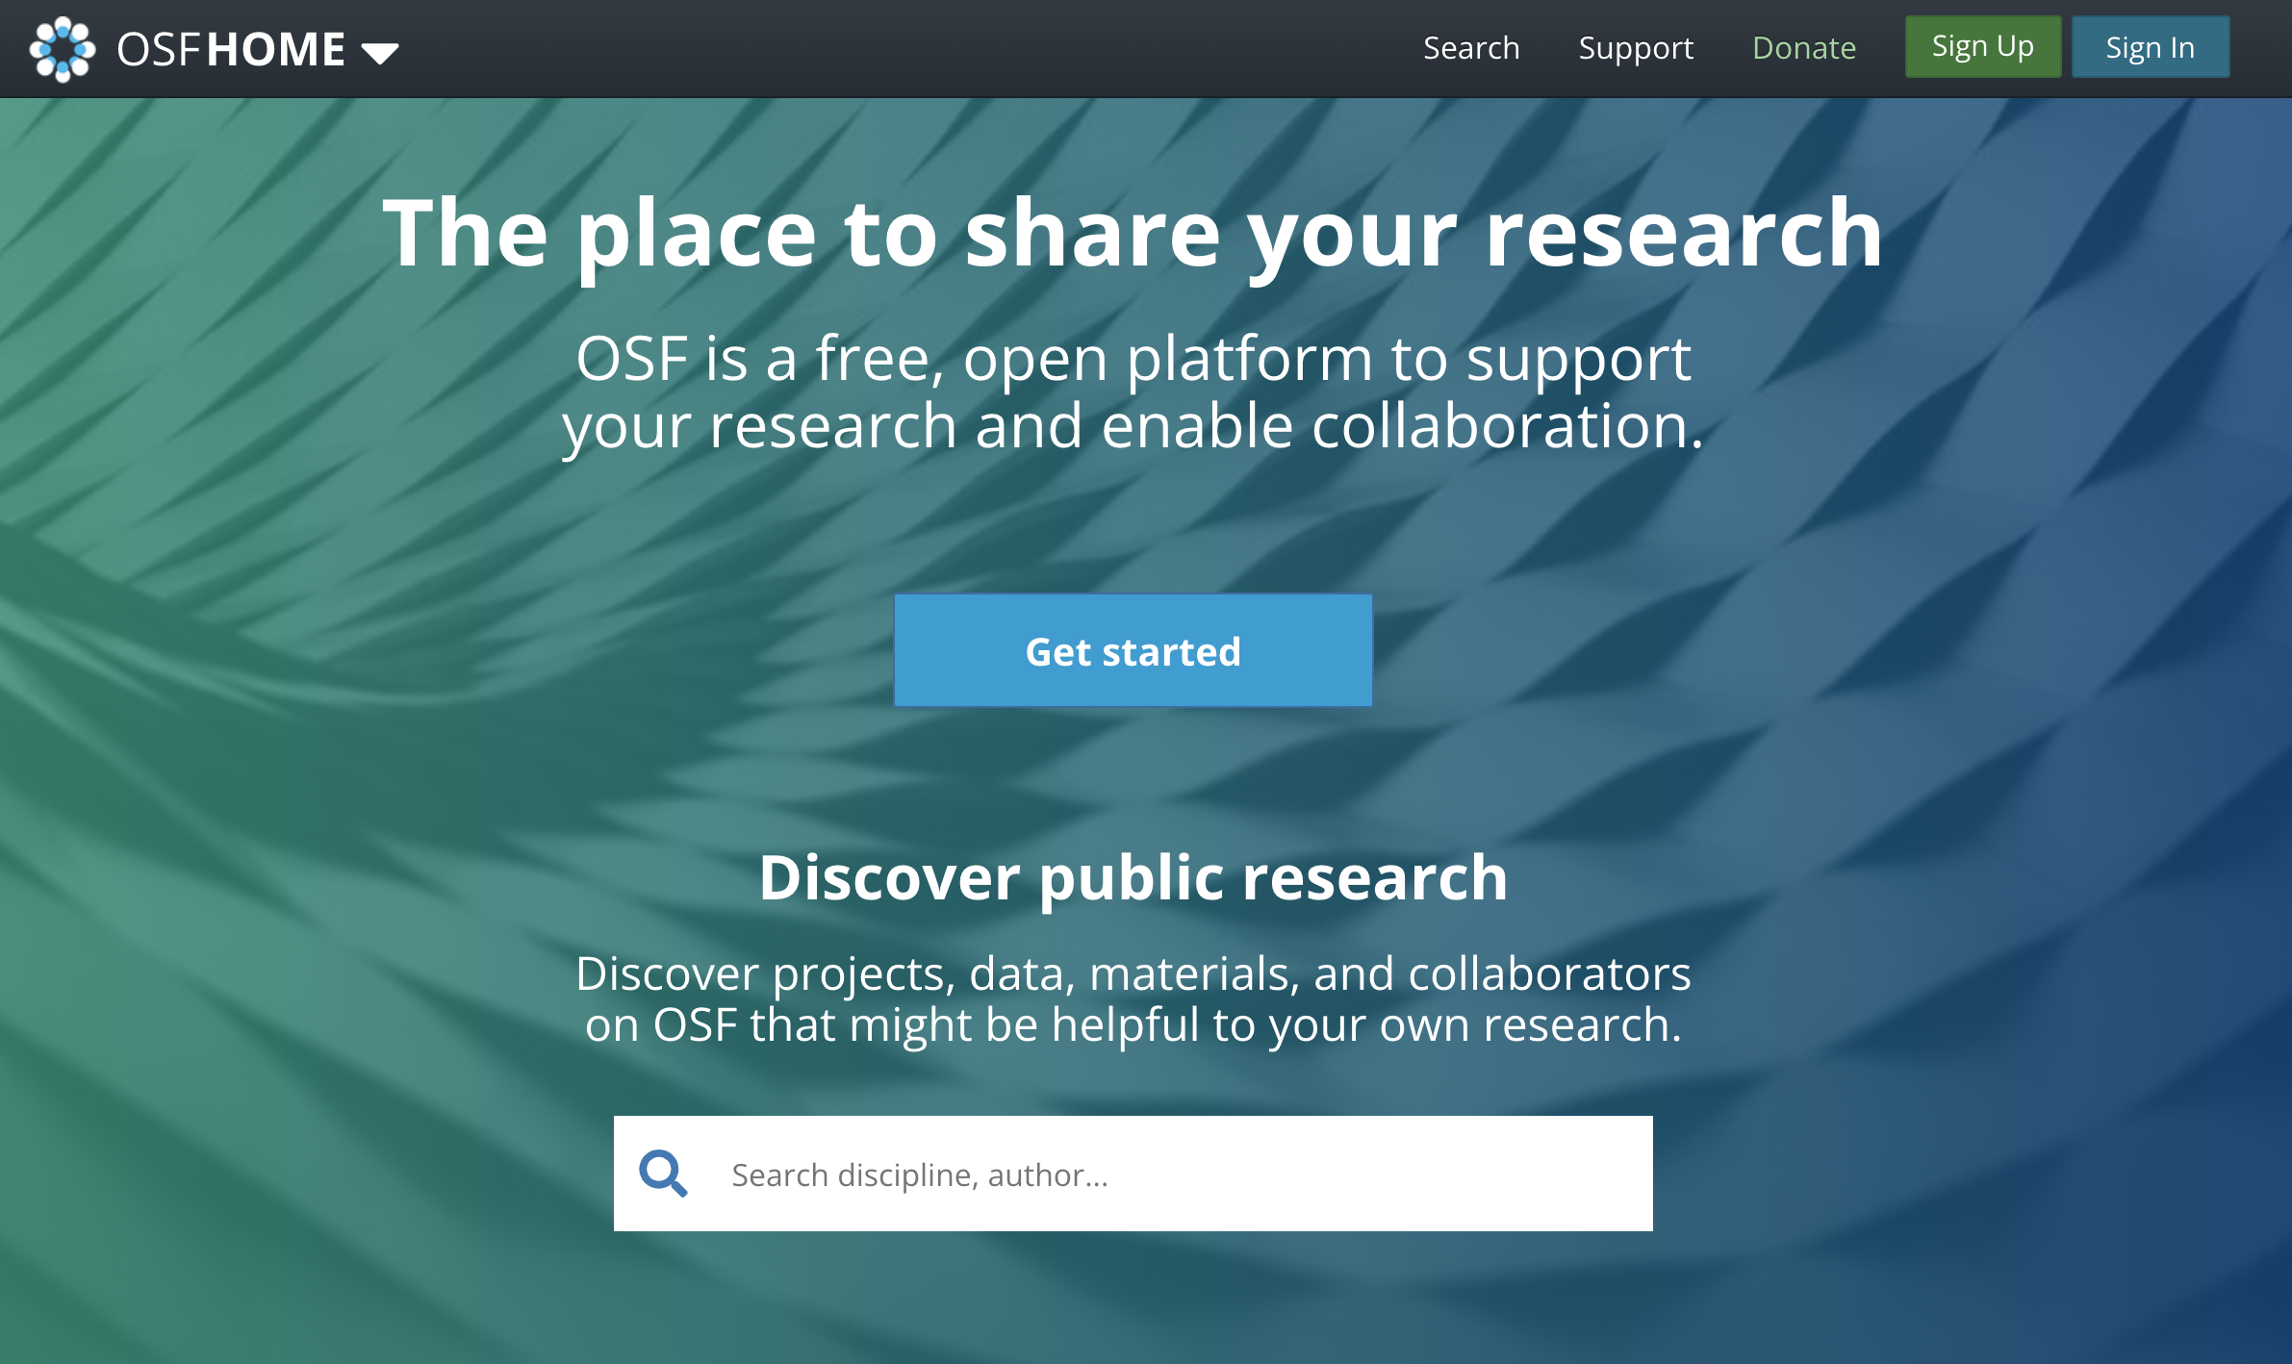
OSF
Preregister study design, hypotheses, analysis plans and scripts
Post-hoc curate documentation for your study across various components (IRB, surveys, stimuli, datasets, codebooks)

Slide 23

PsyArXiv
Publish pre-prints of your paper
Supports immediate sharing of research
https://psyarxiv.com

Slide 24
Markdown
Lightweight markup used to add formatting elements to plaintext documents.
Created by John Gruber in 2004, Markdown is now one of the world’s most popular markup languages.
Using Markdown is different than using a WYSIWYG editor.
In Word, you click buttons in GUI to apply formatting
In Markdown, you add syntax to text to apply formatting
https://www.markdownguide.org/getting-started/

Slide 25
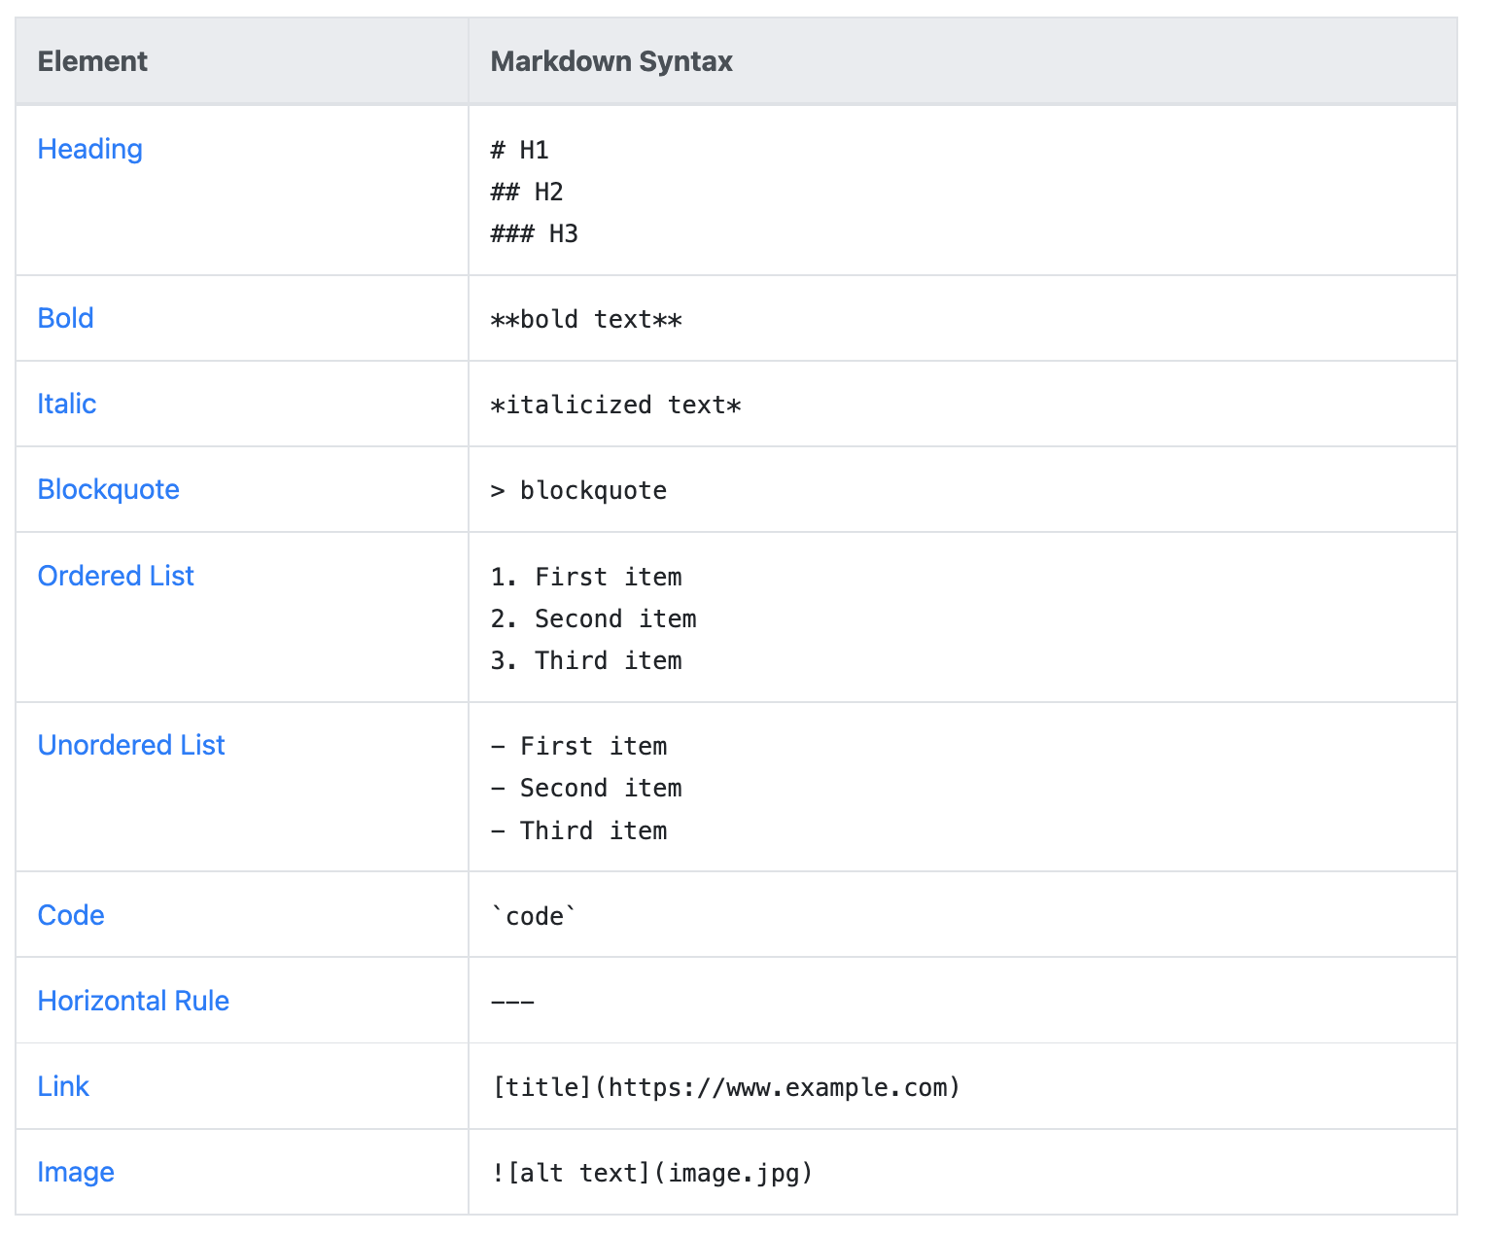

Slide 26
What is Git?
A version control system to manage code; edits, branching, and collaboration.
Git providers
Open source Git: https://git-scm.com/
Github - https://desktop.github.com
Get Github Cheatsheets: https://training.github.com/downloads/github-git-cheat-sheet/
Gitlab

Slide 27
Git These Concepts
Repository: a logical unit of storage for maintaining code/other assets. Can contain many folders, files.
.gitignore: a file (with dot prefix) to specify what files should NOT be pushed to Github
.gitkeep: a file (with dot prefix) to specify that a folder should be kept if blank as part of the project structure. This is helpful when creating templates.
commit: create a record/snapshot of all files (or specific files) at a moment in time. You may tag collaborators, add a title and notes.
push: 'storing' the result of prior commits
pull: 'extracting' the result of prior commits
diff: difference (line-specific) between two commits. Helpful when trying to remember when and where code edits where made.

Slide 28
Orientation to
R, RStudio, RMarkdown

Slide 29
What is R? RStudio?
What is R?
Statistical programming language (released ~1993). Similar to `S` (released ~1976)
Download R: https://cran.r-project.org
What is RStudio?
Integrated development environment (IDE) for R; view data objects, plots, and file directory all in one place.
Download Rstudio: https://www.rstudio.com/products/rstudio/download

Slide 30
What are R packages?
Libraries of code to accomplish specific functions
e.g., data viz, machine learning, data wrangling, compute effect sizes
Think of CRAN as an equivalent to iOS App Store, or Google Play Store
CRAN is where you download published R packages (directly from R, RStudio)
A developer can also make packages available directly in source code, or via tools like Github, for example:
install.packages("devtools")
devtools::install_github("nelsonroque/ruf")

Slide 31
What is RMarkdown? Quarto?
Reproducible notebook (akin to Jupyter Notebooks in Python) where you can write a narrative using Markdown syntax and embed code/plots throughout.
Based on Markdown syntax: https://www.markdownguide.org/basic-syntax/
With R Markdown (and now Quarto), you can generate HTML, PDF, MS Word documents, websites, PowerPoint presentations, and books!
Learn More:
https://quarto.org/docs/authoring/markdown-basics.html

Slide 32
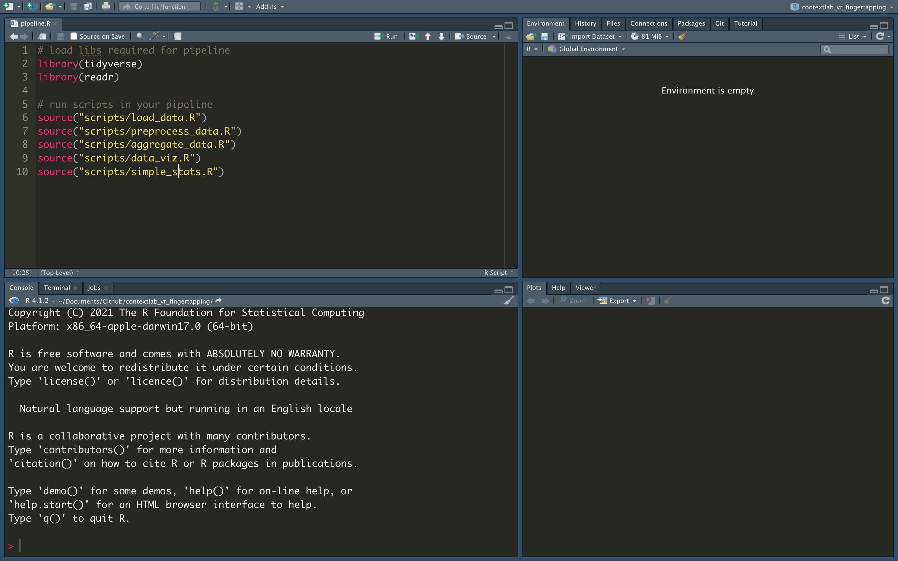
Scripts

Slide 33
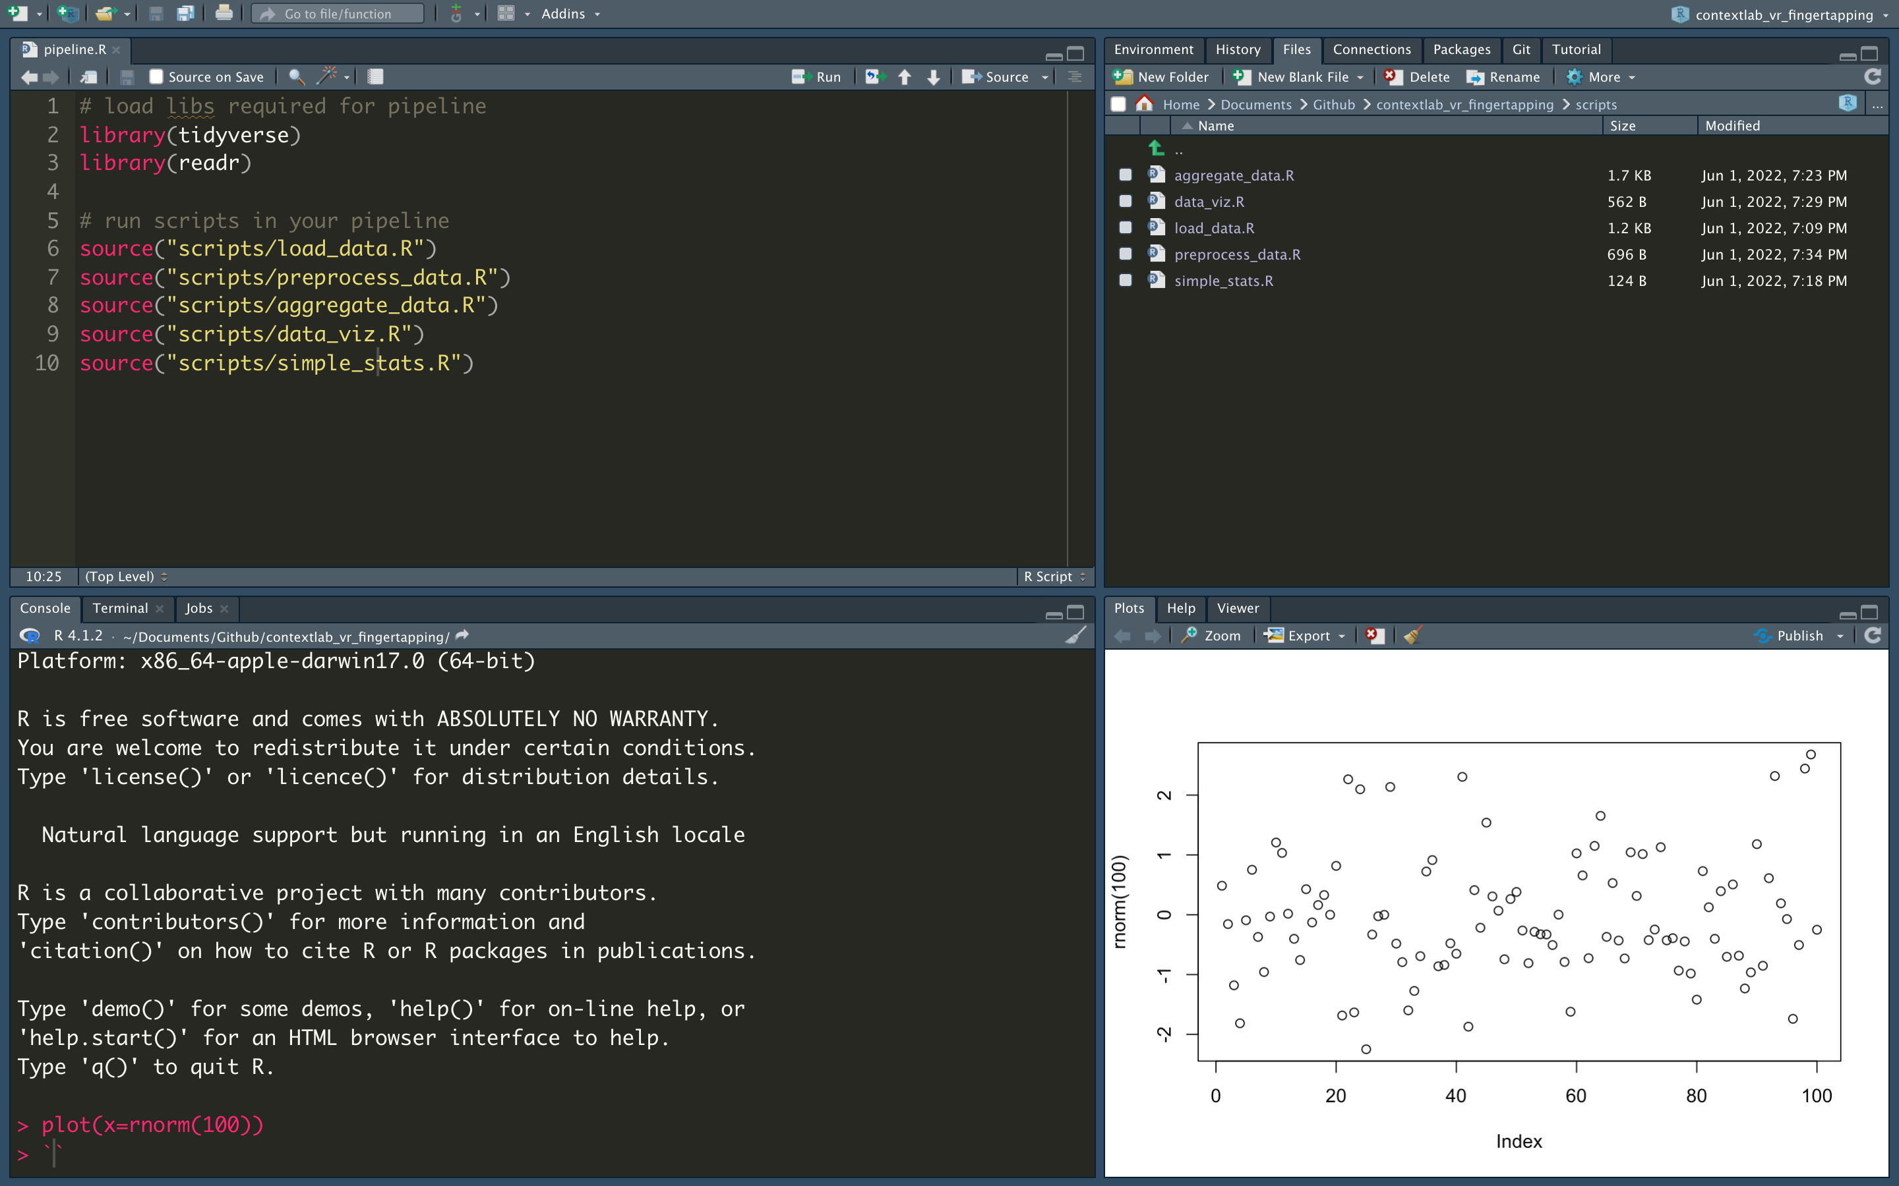
Files

Slide 34
Console: run one-off commands

Slide 35
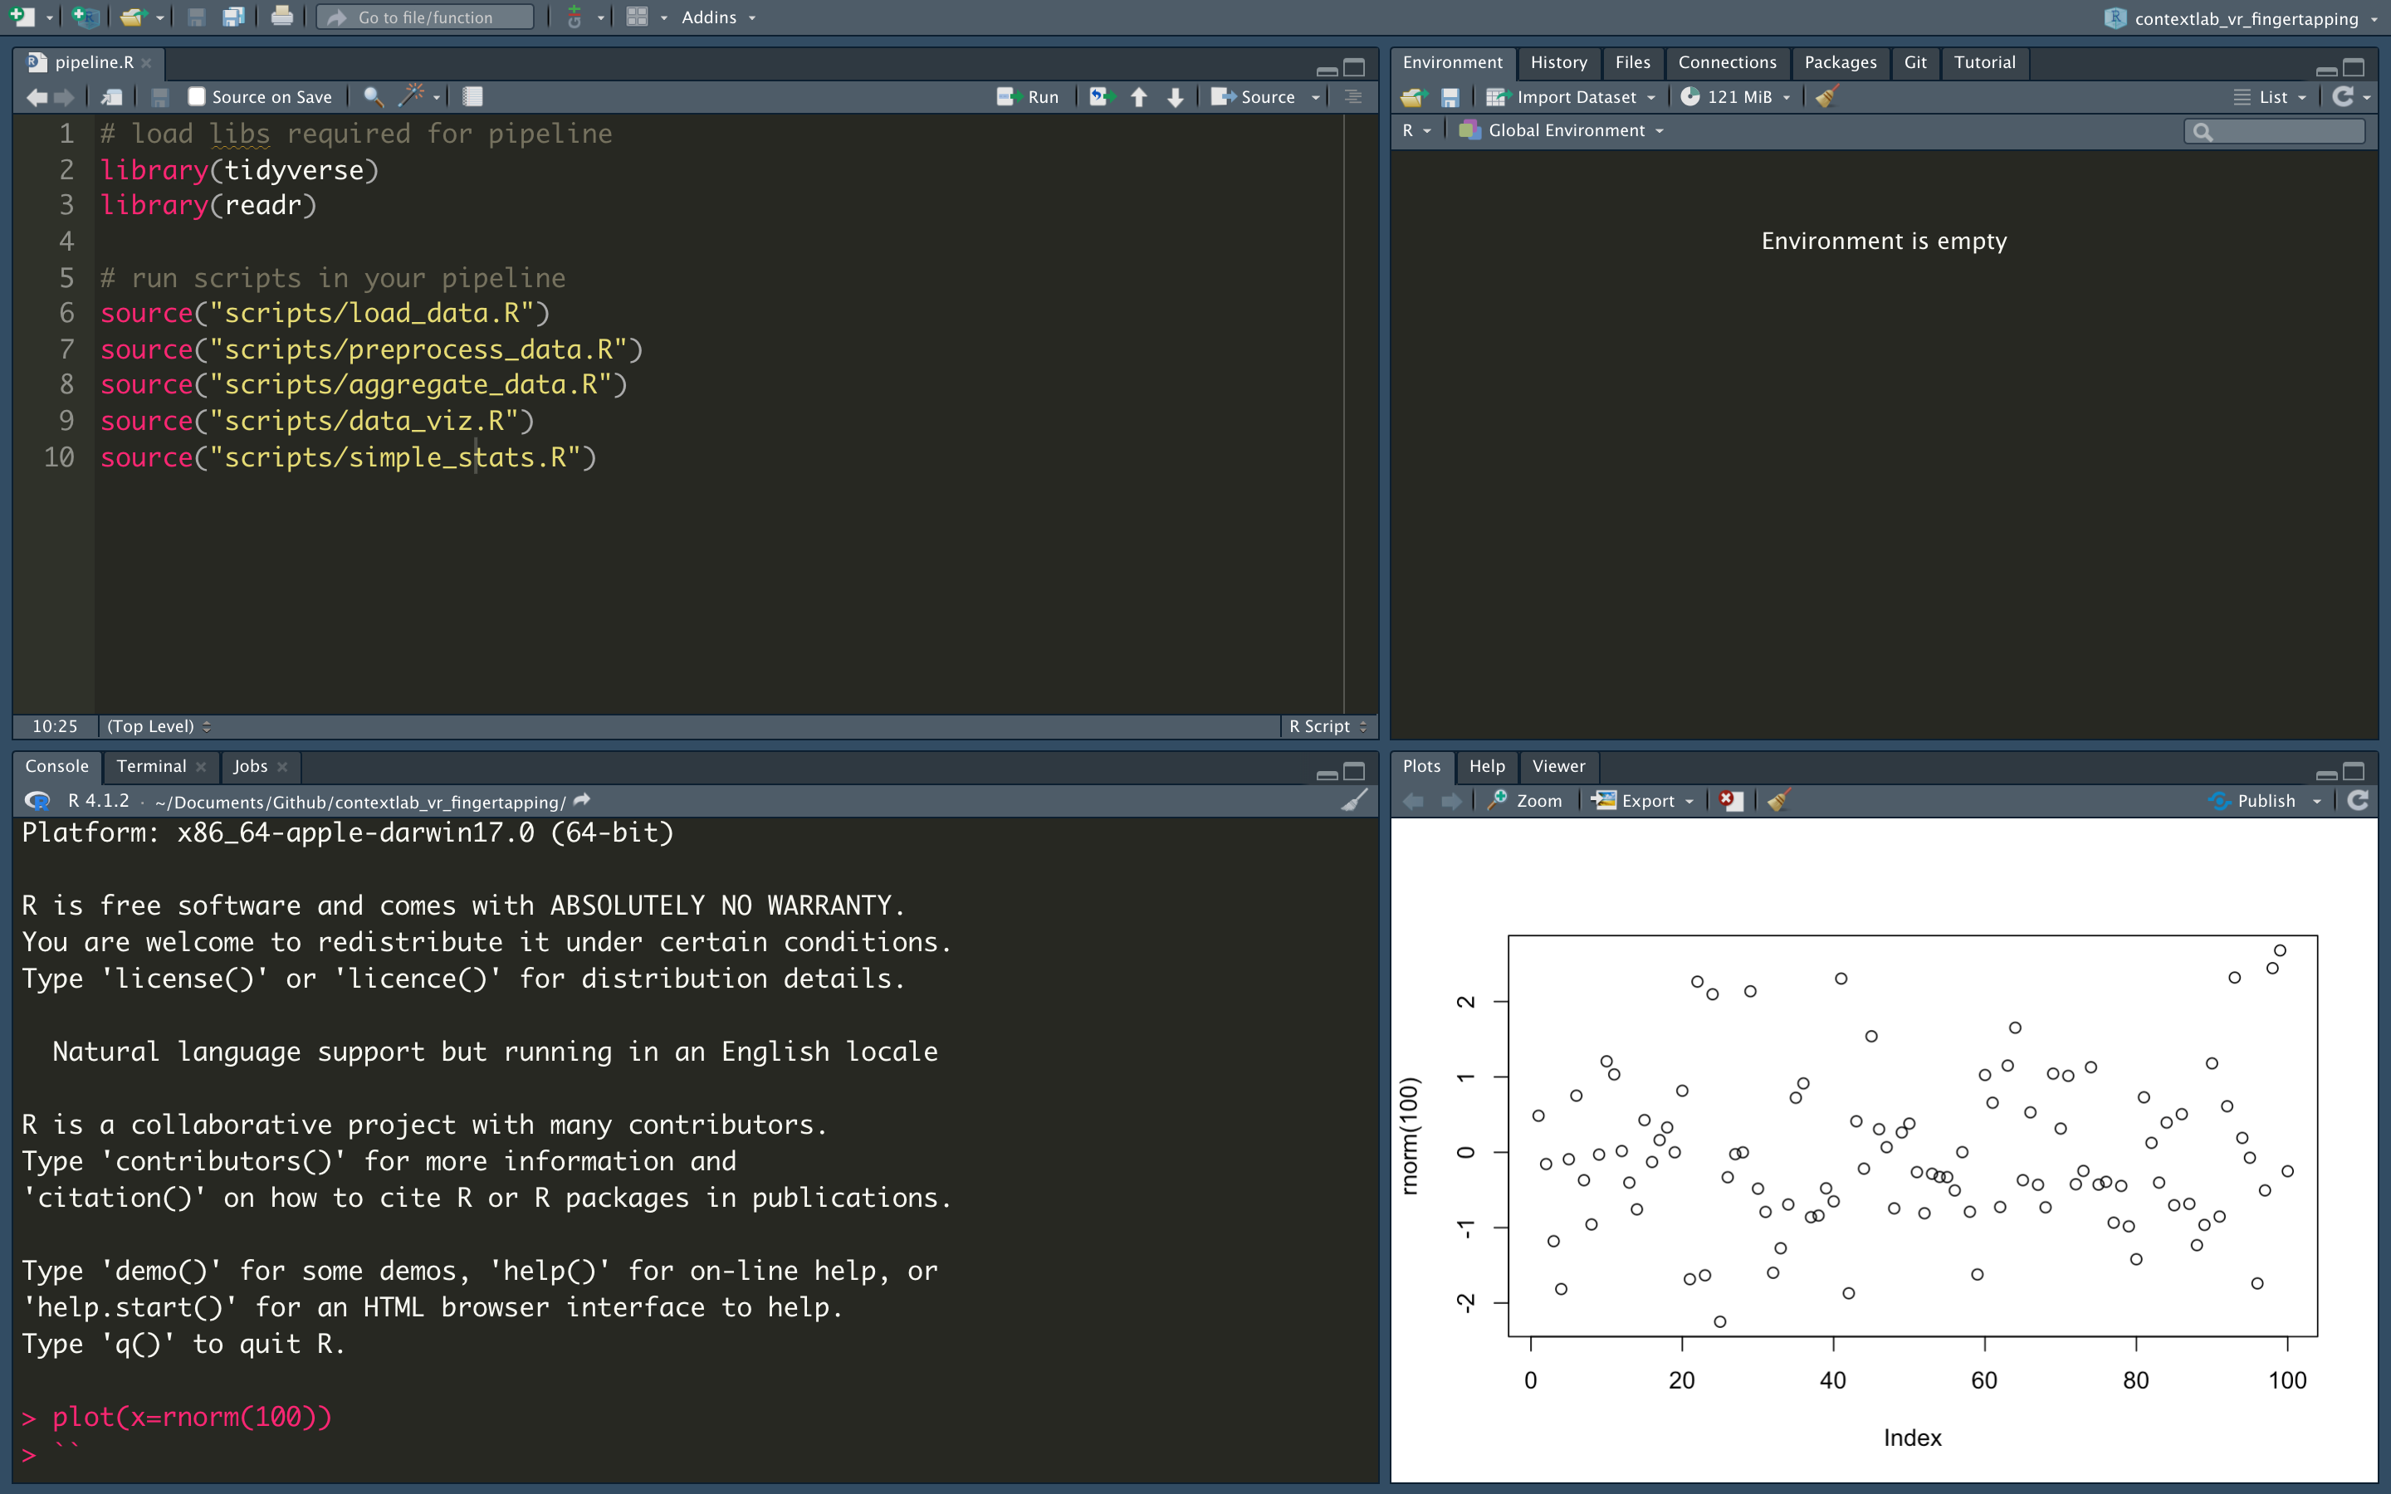
Plots

Slide 36
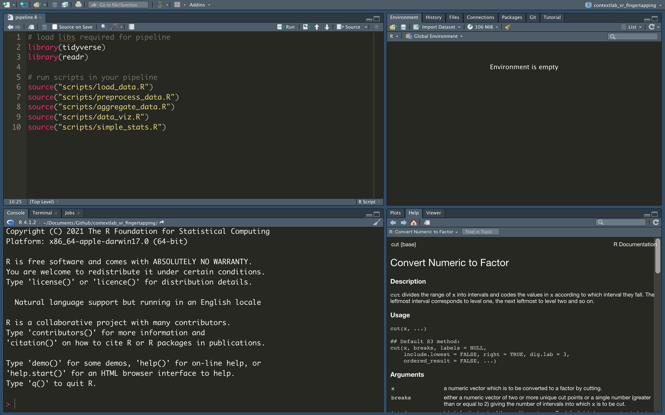
Help

Slide 37
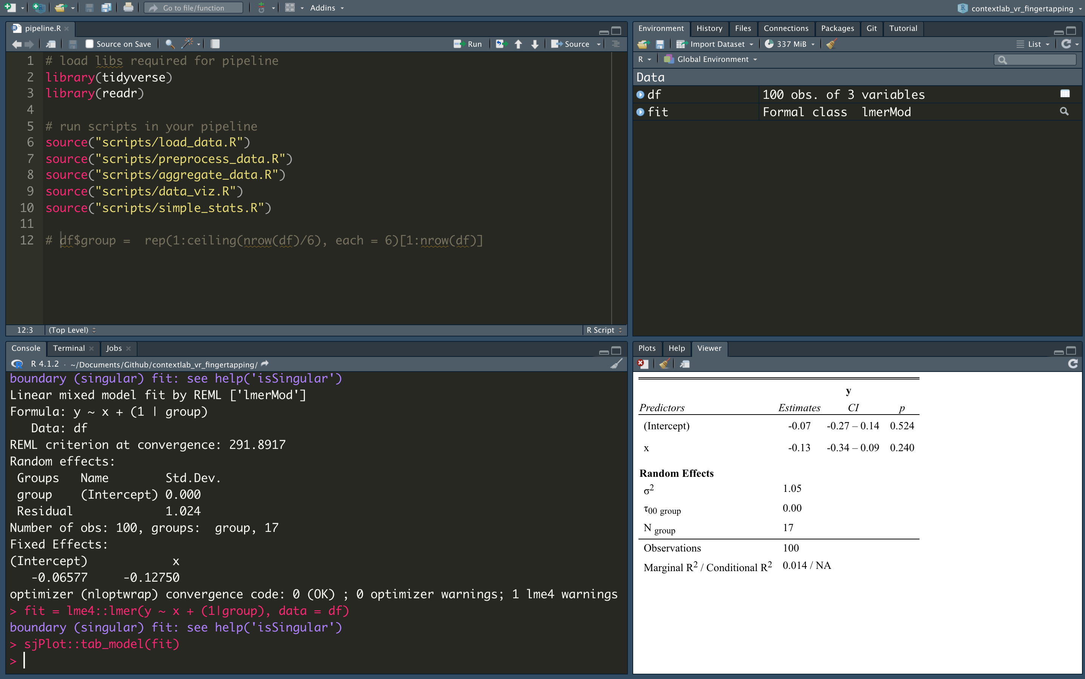
Viewer

Slide 38
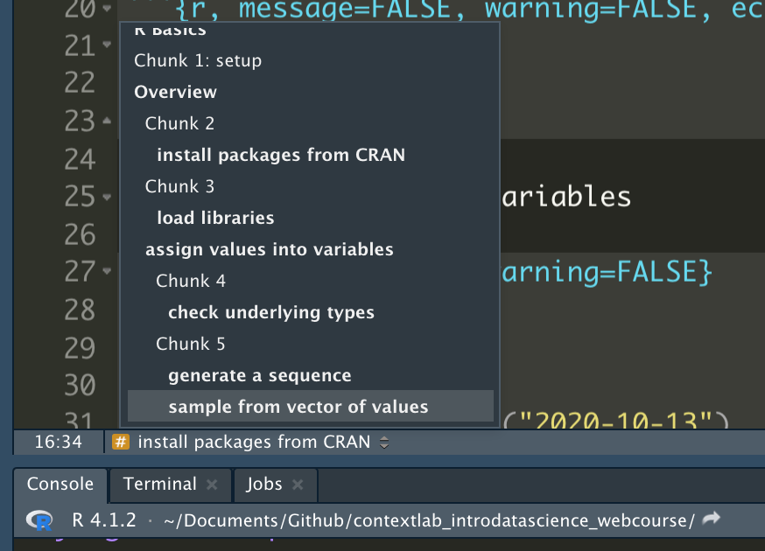
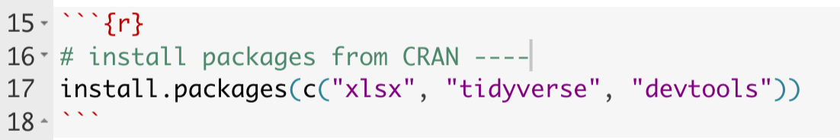
Shortcuts
Command+Enter (Mac) or Ctrl+Enter (Windows) to run the line where your mouse cursor is (or a highlighted selection of code)
Add “-----” inside of a comment to create a shortcut

Slide 39
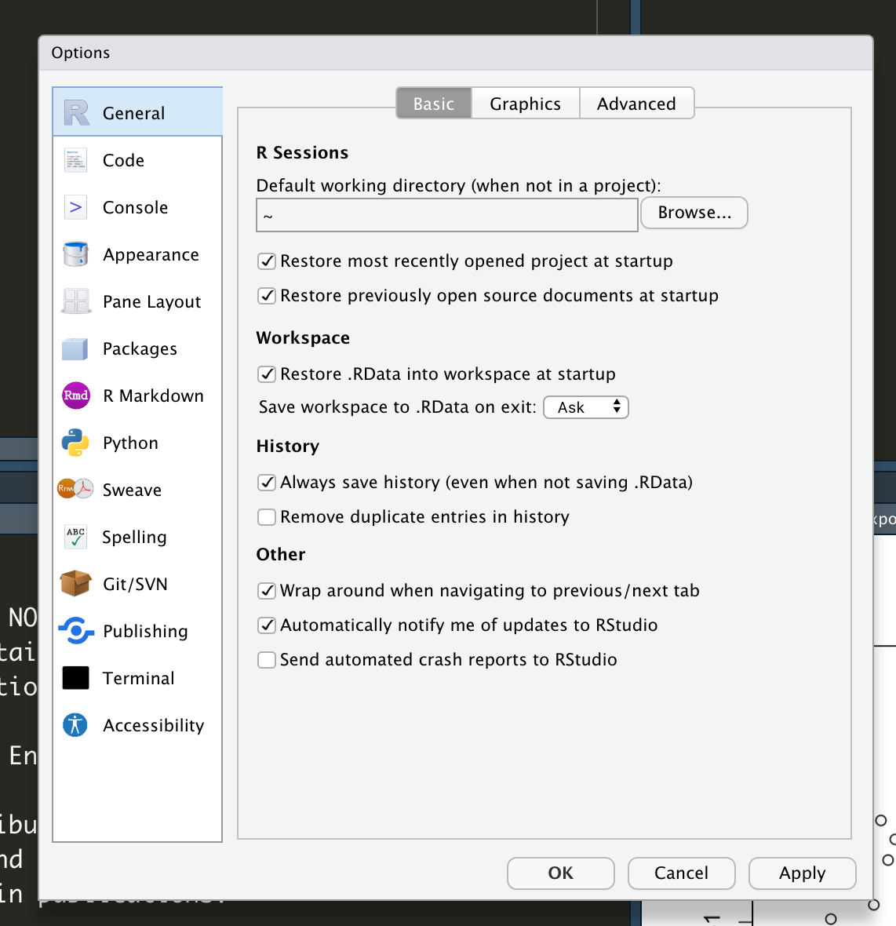
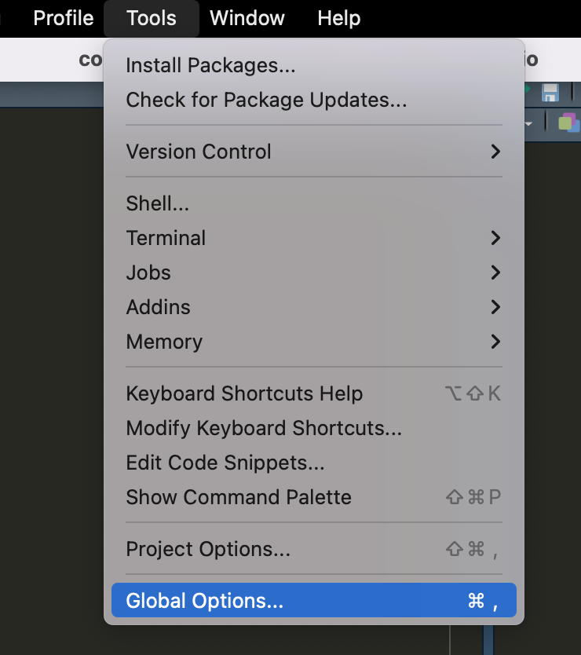
Customizing RStudio

Slide 40
Intro to R Syntax

Slide 41
Pseudocode Exercise
You allowed participants on Qualtrics to enter state of residence as free text entry, resulting in e.g., Florida, as:
FL, Fl, Florida, FLORIDA
Goal: Ideally you want them all to be two upper case letters. In words only (no code), describe your approach to solving the data problem above.

Slide 42
Basic data types & structures
Character: text data
Numeric: all real numbers with or without decimal values
Integer: real values without decimal points
Logical: TRUE, FALSE
Raw: raw bytes of data
List: named or numbered array of entries
Data frame and tibble: rectangular representation of data
Vector
Matrix
https://www.programiz.com/r/data-types
Notes:
https://www.programiz.com/r/data-types

Slide 43
Let’s jump into R
Scan the QR code to view the code we will work with
Notes:
Scipts we will go over
https://github.com/nelsonroque/contextlab_reproduciblescience_workshops/blob/main/scripts/03-r-basics.Rmd
https://github.com/nelsonroque/contextlab_reproduciblescience_workshops/blob/main/scripts/04-r-pipeline.Rmd
https://github.com/nelsonroque/contextlab_reproduciblescience_workshops/blob/main/scripts/05-date-manipulation.Rmd

Slide 44
Data Wrangling

Slide 45
Uncleaned Data Problems
In a perfect data-generating system, data are already tidy
In practice, we must first determine
data structure issues, including:
Column headers are values, not variable names.
Multiple variables are stored in one column.
Variables are stored in both rows and columns.
Multiple types of observational units are stored in the same table.
A single observational unit is stored in multiple tables.
Data quality issues
Values out of range
Improperly/inconsistently coded response options
Inconsistent records counts

Slide 46
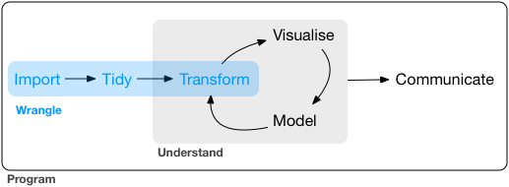
What is data wrangling?
The operations that carry your data from raw form, into something visualizable or analyzable
i.e., the data preparation phase of the research
Notes:
https://vita.had.co.nz/papers/tidy-data.pdf

Slide 47
What is tidy data?
Every column is a variable.
Every row is an observation.
Every cell is a single value.
participant | condition | avg_response_time | perc_accur
9991 | control | 506 | 90
9992 | active | 516 | 96
9993 | control | 526 | 99
Source: R for Data Science
Notes:
https://vita.had.co.nz/papers/tidy-data.pdf

Slide 48
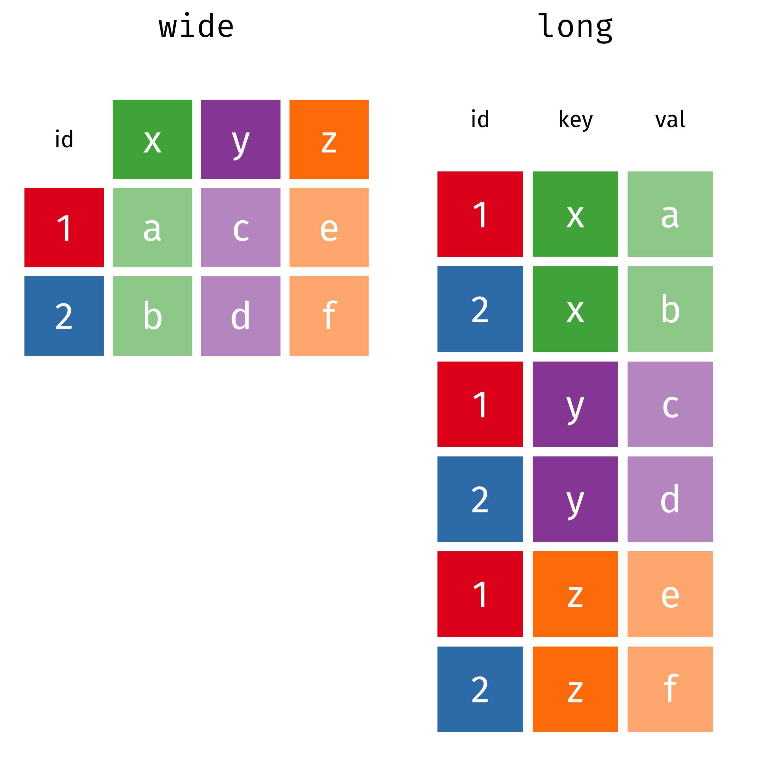
Typical data wrangling operations
Data exploration
Plotting, descriptive stats
Dealing with missing data
Impute missing data, insert missing codes (-999)
Reshaping data
Add columns (e.g., create flag is missing more than 10 records)
Update column names (id = participant_id)
Converting between long and wide format
Notes:
Graphics from: https://www.garrickadenbuie.com/project/tidyexplain/#usage
https://github.com/gadenbuie/tidyexplain

Slide 49
Typical data wrangling operations
Filtering data
Remove specific observations, by column or row
Merging/matching data from various sources
Join data by common id(s) in various ways (more on next slides)
https://dplyr.tidyverse.org/articles/two-table.html
Other wrangling
Feature engineering
E.g., Add ‘features’ of date as new columns (e.g., what is day of week for 10/13/2020)

Slide 50
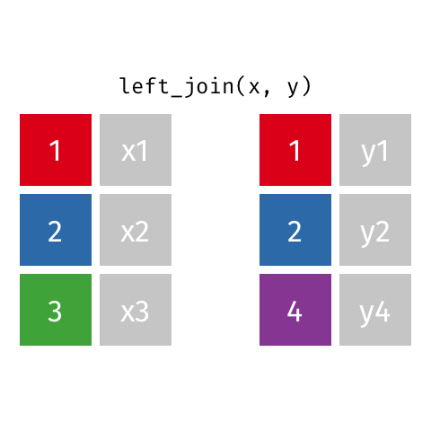
Joining data
Left join
All rows from x, and all columns from x and y. Rows in x with no match in y will have NA values in the new columns.
Notes:
Graphics from: https://www.garrickadenbuie.com/project/tidyexplain/#usage
https://github.com/gadenbuie/tidyexplain

Slide 51

Joining data
inner join
All rows from x where there are matching values in y, and all columns from x and y.
Notes:
Graphics from: https://www.garrickadenbuie.com/project/tidyexplain/#usage
https://github.com/gadenbuie/tidyexplain

Slide 52
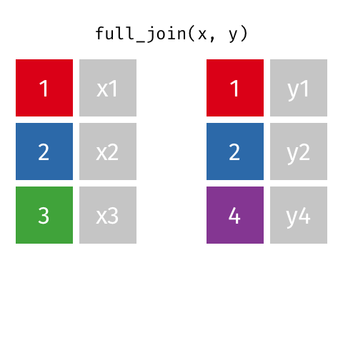
Joining data
full join
All rows and all columns from both x and y.
Where there are not matching values, returns NA for the one missing.
Notes:
Graphics from: https://www.garrickadenbuie.com/project/tidyexplain/#usage
https://github.com/gadenbuie/tidyexplain

Slide 53
Data Visualization

Slide 54

Five Qualities of Great Visualizations
Truthful: transparency in decision making and reporting
Functional: understandable, uncluttered
Beautiful: plots can be art too
https://playingthearchive.com
Insightful: reveal trends or relationships
Enlightening: integration of 1-4 executed succesfully

Slide 55
Primer: dplyr + ggplot2 (part of the tidyverse)
dplyr
select() = select certain columns
contains(“timer”)
-contains(“timer”)
mutate() = append or modify a column
group_by() = group output of analysis by grouping factors
%>% = pipe (chaining operator)
ggplot2
geom_bar()
geom_point()
geom_line()
geom_histogram()
facet_grid, facet_wrap
theme_bw(), theme_minimal(), theme(element_text(angle=90, font-family=“Arial”))

Slide 56
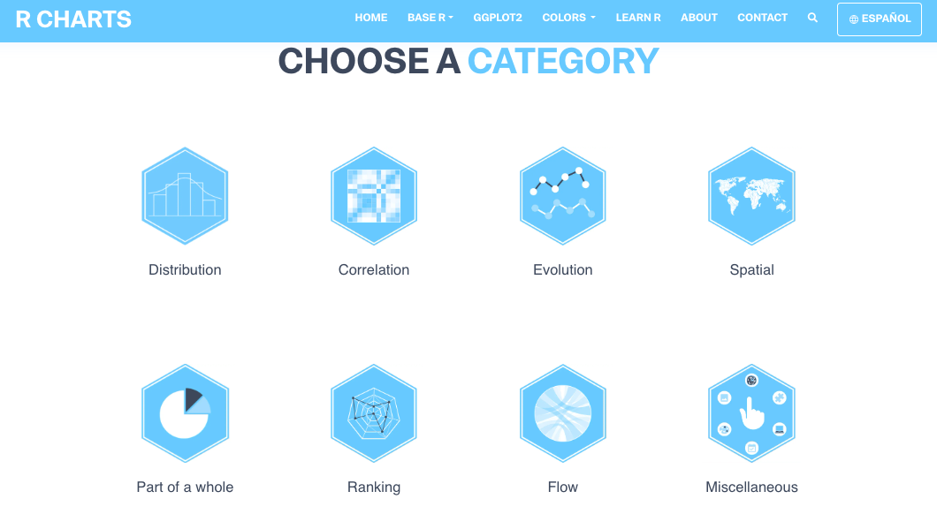
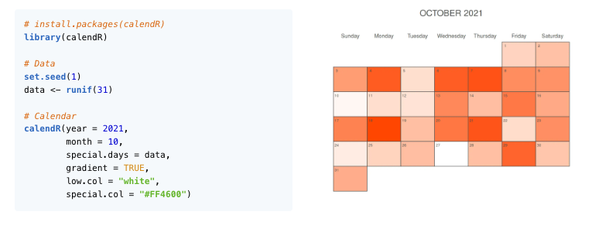

Slide 57
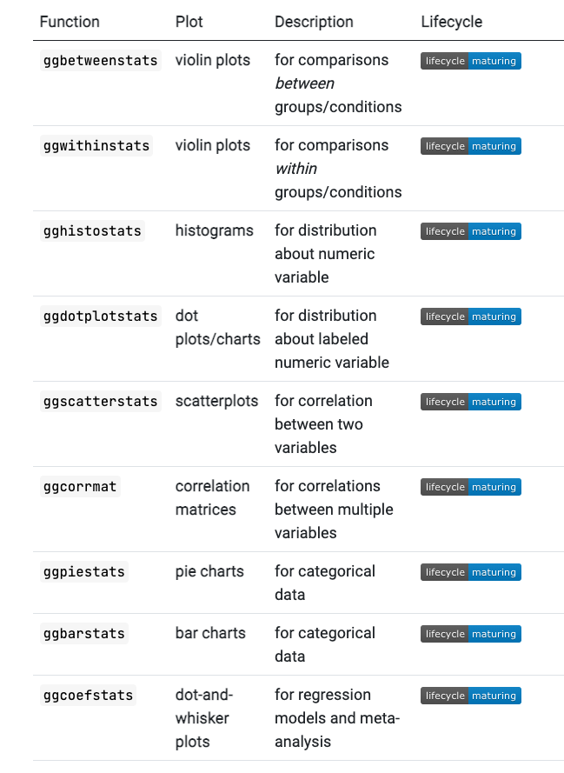
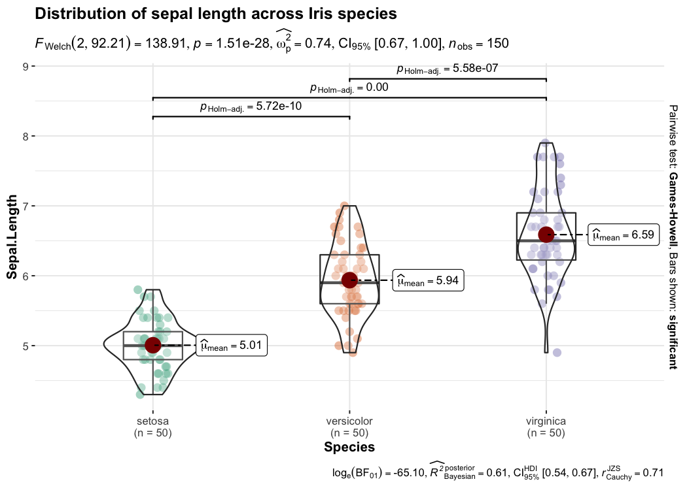
ggstatsplot
Notes:
https://indrajeetpatil.github.io/ggstatsplot/

Slide 58
Let’s jump into R
Scan the QR code to view the code we will work with
Notes:
2-r-basics.Rmd

Slide 59
Working with APIs

Slide 60
What is an API?
Application Programming Interface
Method to communicate with the data layer of an application to accomplish business / research function, e.g.,
Store and query data
Update settings
Login/logout
Retrieve resources (e.g., images)
APIs make the modern world go round
From airlines, to your groceries, to functionality in almost every mobile app, APIs are charged with securely and efficiently shipping data back and forth between entities and their consumers.

Slide 61
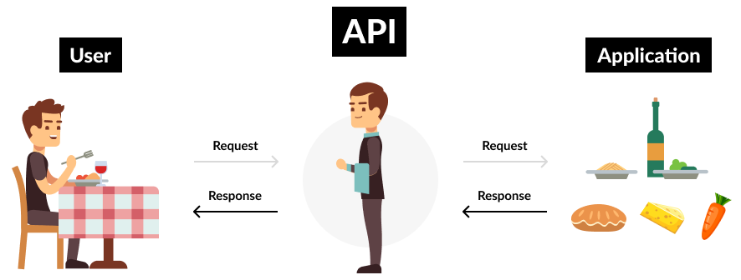
What is an API?
https://www.mindtree.com/insights/blog/rise-apis-financial-services-key-future
Notes:
Image: https://www.mindtree.com/insights/blog/rise-apis-financial-services-key-future

Slide 62
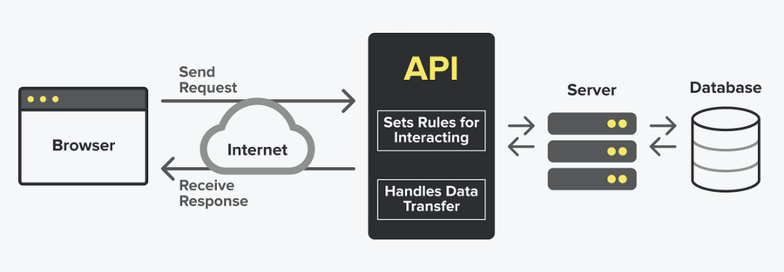
What is an API?
https://snipcart.com/blog/integrating-apis-introduction
Notes:
Image: https://snipcart.com/blog/integrating-apis-introduction

Slide 63
Jeff Bezos’ API Mandate at Amazon
All teams will henceforth expose their data and functionality through service interfaces.
Teams must communicate with each other through these interfaces.
There will be no other form of interprocess communication allowed: no direct linking, no direct reads of another team’s data store, no shared-memory model, no back-doors whatsoever. The only communication allowed is via service interface calls over the network.
It doesn’t matter what technology they use.
All service interfaces, without exception, must be designed from the ground up to be externalizable. That is to say, the team must plan and design to be able to expose the interface to developers in the outside world. No exceptions.
Anyone who doesn’t do this will be fired.
Thank you; have a nice day!
https://nordicapis.com/the-bezos-api-mandate-amazons-manifesto-for-externalization

Slide 64
Special Considerations
Authentication confirms identity, while authorization determines access rights.
Authentication is the process of verifying the identity of a user or system. It confirms that the user or system is who they claim to be.
Authorization is the process of determining whether a user or system has permission to access a specific resource or perform a specific action. It checks whether the authenticated user or system has the necessary privileges to perform the requested operation.
Rate-limiting
Query by offsets and limits

Slide 65
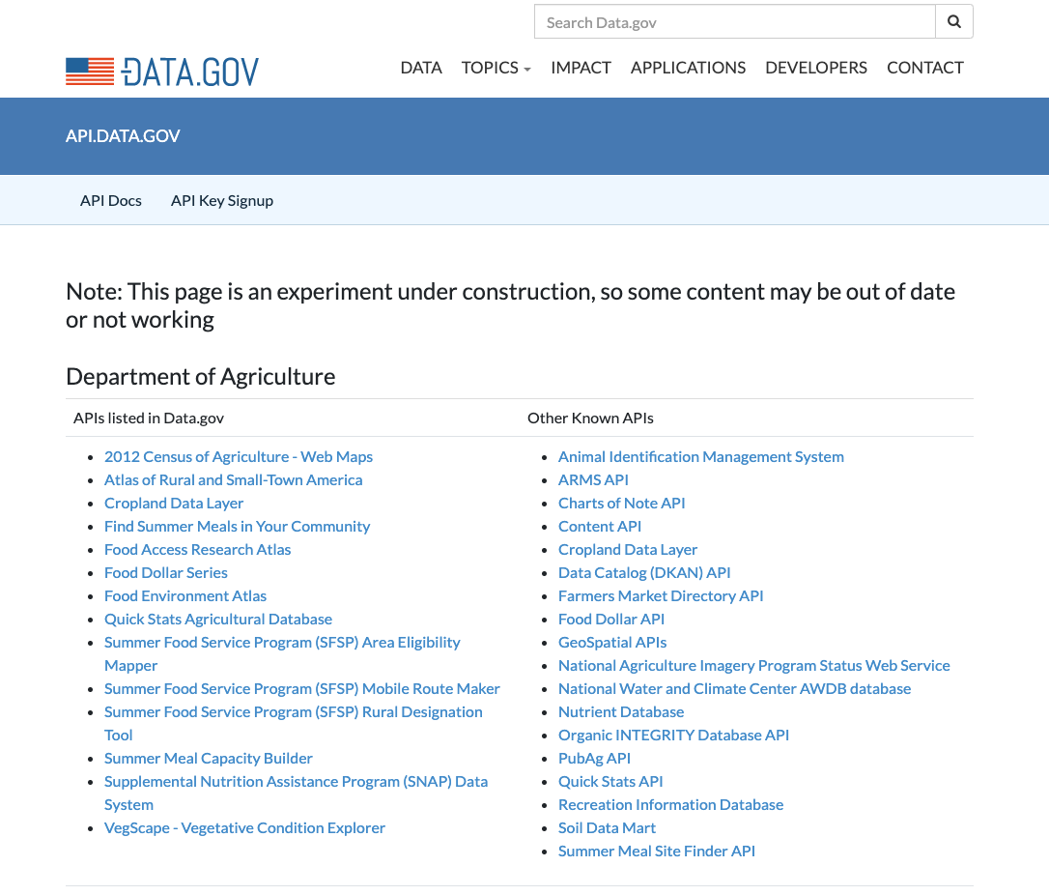
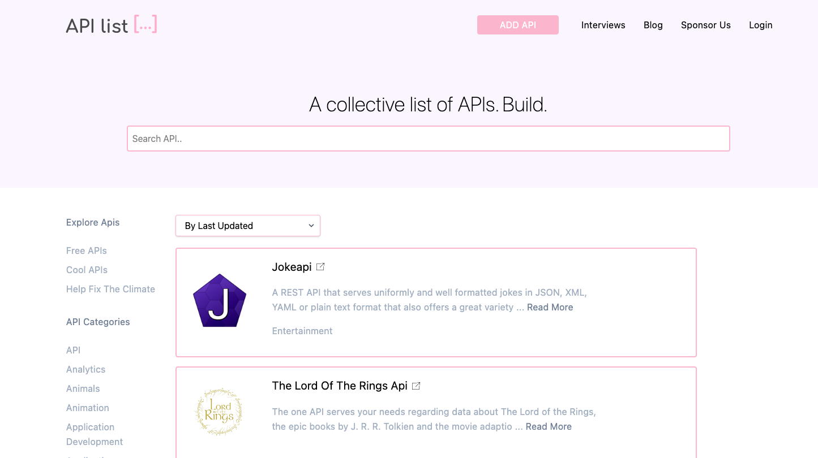

Slide 66
Let’s jump into R
Scan the QR code to view the code we will work with
Notes:
2-r-basics.Rmd

Slide 67
Data Science: Latest Trends

Slide 68
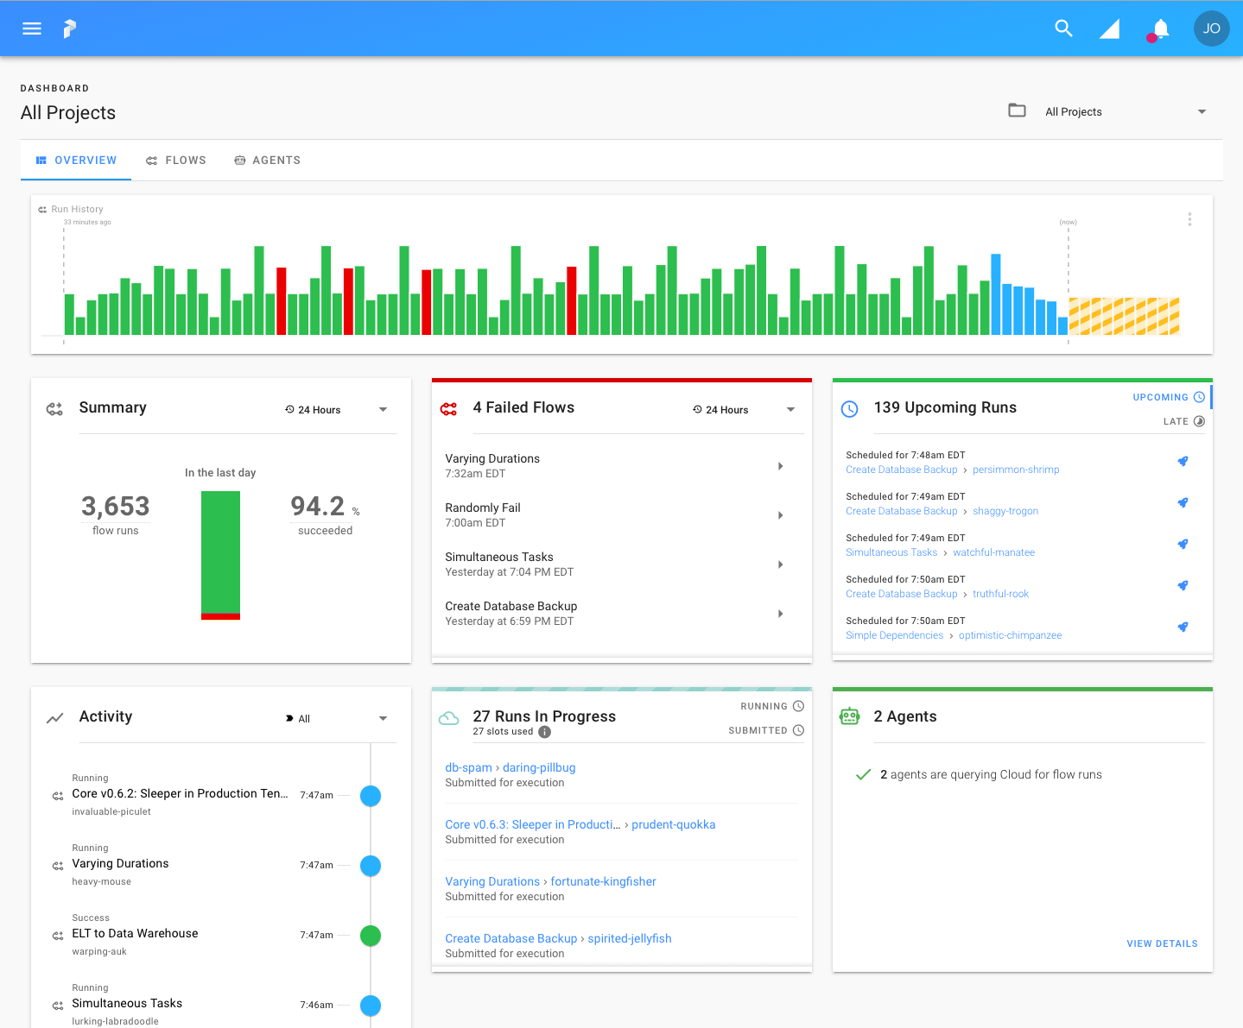
ETL Pipelines
Extract
Programmatically download data from origin (database, file server)
Transform
Manipulate, score, reformat data as needed for computational needs
Load
Re-save transform dataset(s) in new location on origin server (or other server)

Slide 69
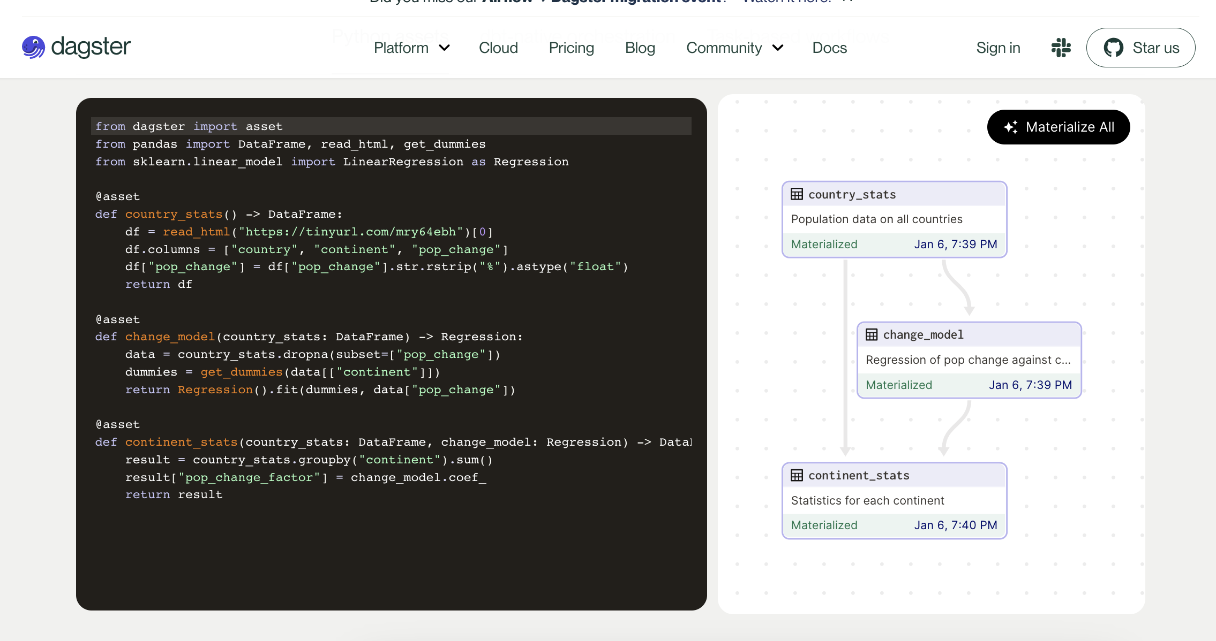

Slide 70
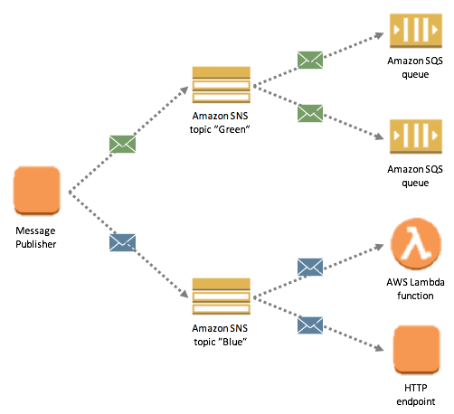
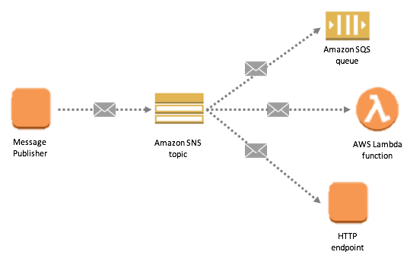
What is PubSub?
Messaging pattern for loosely coupled communication between highly cohesive components
Why PubSub?
Scalable, fault-tolerant, and highly available

Slide 71
How I’ve Used PubSub Messaging
Send a message to a topic for each device in a study, and query all data for last X days from device API
e.g., Fitbit, Air quality devices
Send a message to a topic for each cognitive task, query respective data, score it, and publish to API/store in new database table

Slide 72








Automating data jobs with PubSub
Publish job
Process job
Notify
{
“JOB_TYPE”: “score”, “STUDY_ID”: “TMB”
}
Function score_job()
Job complete!
On schedule
i.e., send message to SNS topic (e.g., JSON format, string)
Upon detecting new message on topic, job processor applies necessary algorithms and sends data to next step
Send job status to SMS, Teams, Slack, etc
Amazon EventBridge
Amazon Lambda
Amazon SNS

Slide 73
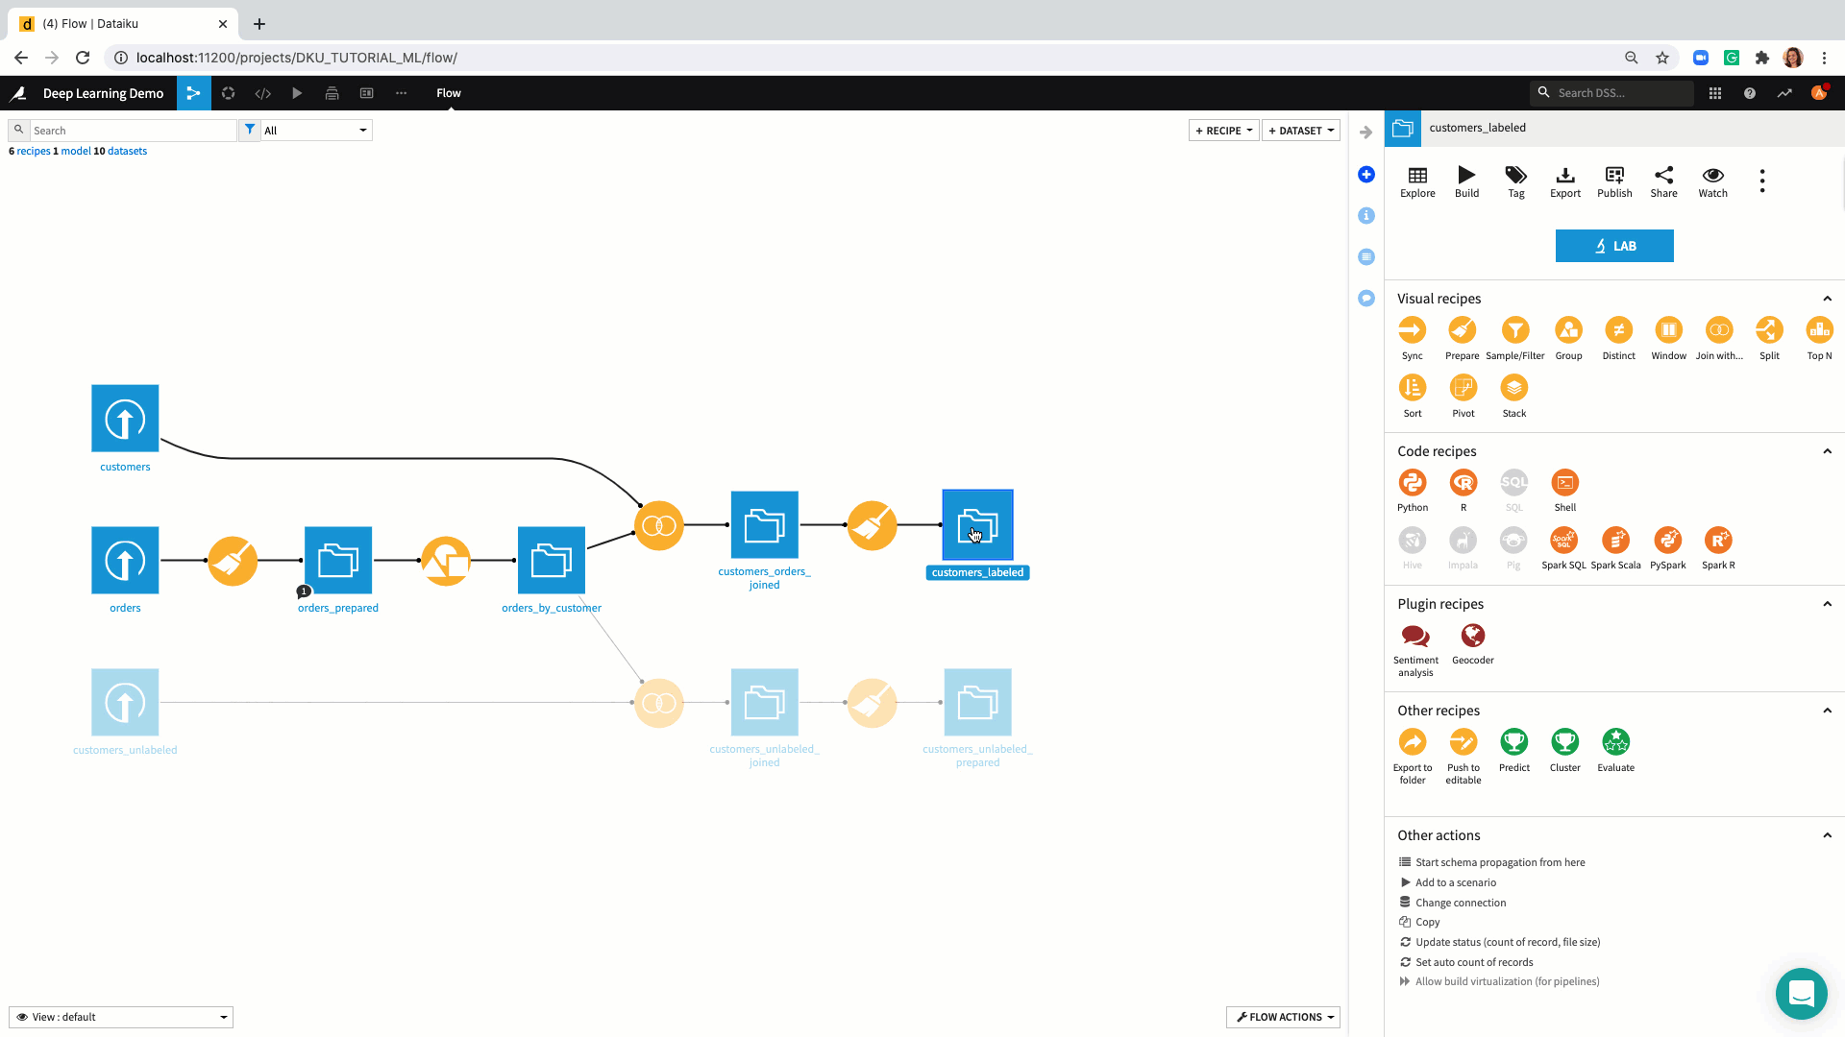

The Future: Data Workflows
Seamless integration platforms, for example:

Slide 74
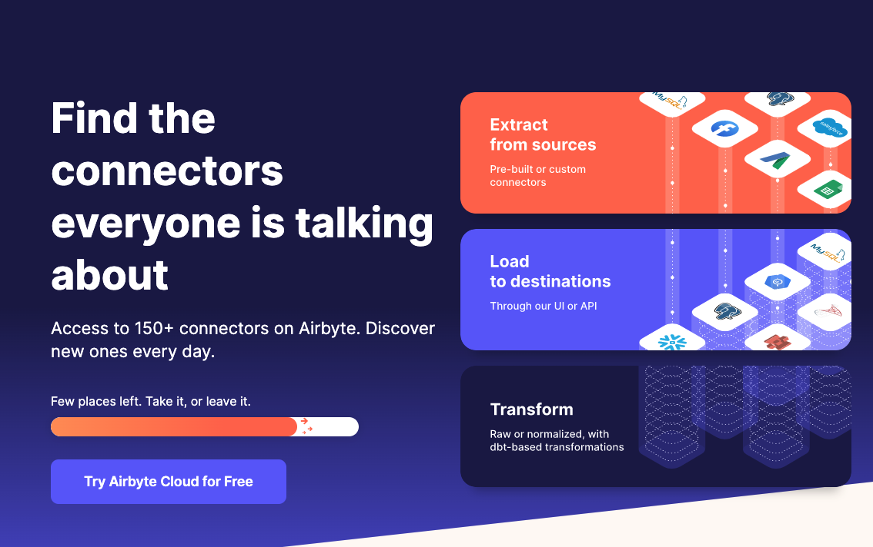
The Future: No-code data transform

Slide 75
Long-term learning

Slide 76
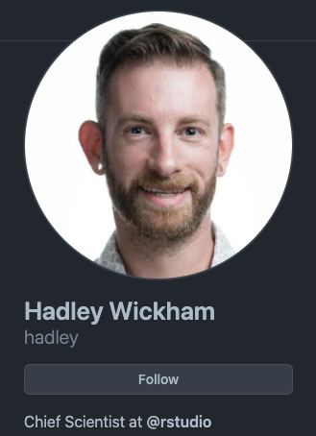
Tutorial Recommendations
Anything by Hadley Wickham
https://www.r-bloggers.com/
https://www.r-statistics.com/
https://blog.revolutionanalytics.com/
https://r-charts.com/
http://www.cookbook-r.com/Graphs/
https://plotly.com/r/

Slide 77

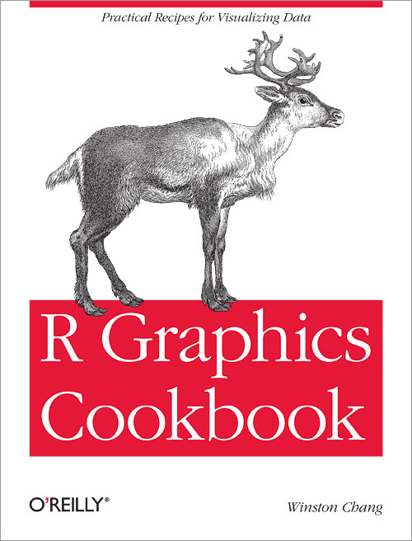
Reading Recommendations
https://r4ds.had.co.nz
https://r-graphics.org

Slide 78
Practice with Open Data
Kaggle
https://www.kaggle.com/datasets
Data.gov
https://www.data.gov/
Google Dataset Search
https://datasetsearch.research.google.com/

Slide 79
You are not alone
Data Import
https://github.com/rstudio/cheatsheets/raw/master/data-import.pdf)
Data Wrangling Cheatsheet
https://www.rstudio.com/wp-content/uploads/2015/02/data-wrangling-cheatsheet.pdf)
Data Transformation with dplyr
https://github.com/rstudio/cheatsheets/raw/master/data-visualization.pdf)
String Manipulation
https://github.com/rstudio/cheatsheets/raw/master/strings.pdf)
Work with dates/times
https://github.com/rstudio/cheatsheets/raw/master/lubridate.pdf)
R Markdown
https://github.com/rstudio/cheatsheets/raw/master/rmarkdown.pdf)
More cheatsheets
https://www.rstudio.com/resources/cheatsheets/)

Slide 80

You are not alone

Slide 81
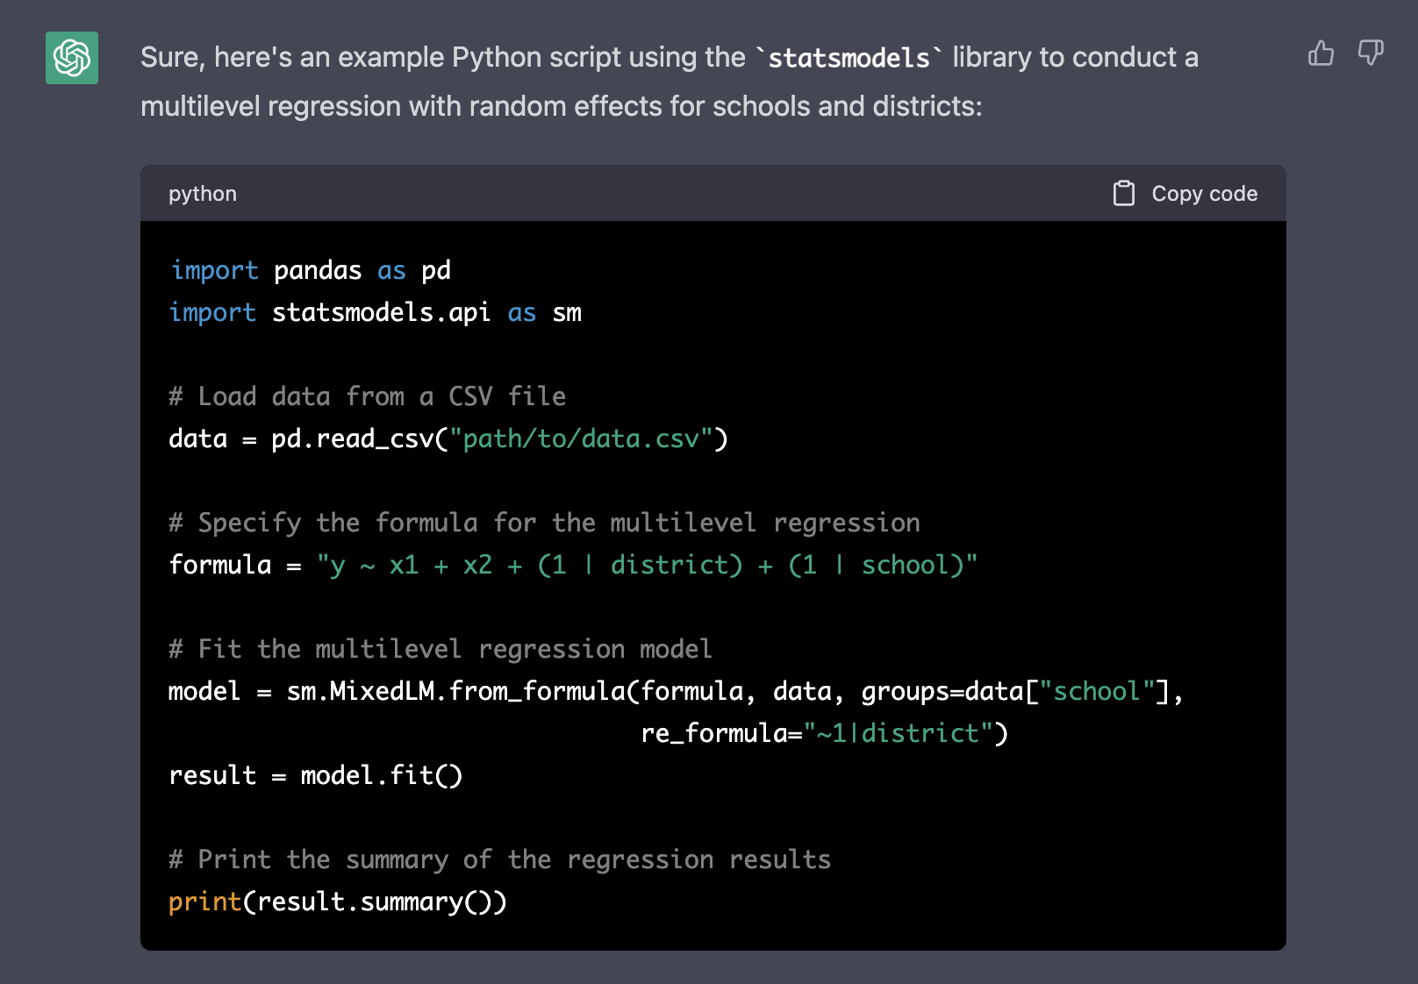

Slide 82




Assessing Proactive Interference via Generative Artificial Intelligence (AI)
“An indoor lounge area with a pool in the middle, with a flamingo inside, vaporwave aesthetic, in the style of [INSERT STYLE]”

Slide 83
Thank you!
Closing Discussion
Q&A
What other topics could be helpful in supporting your research?
Working with, and creating APIs?
Working with image data? Video data?
Geographic data + geocoding?
Eyetracking? Emotion detection?
Machine learning?

Slide 84









nelson.roque@ucf.edu
nelsonroque.com
https://github.com/nelsonroque
thank
you

